Slide 1
INNOVATION IDEA

Slide 2
One innovative idea for IoT-based air quality monitoring is to develop a decentralized network of low-cost, portable air quality sensors that can be easily deployed by individuals and communities. These sensors could connect to a central platform through the Internet of Things (IoT) to provide real-time data on air quality.​
Stationary Devices: Install stationary IoT devices in strategic locations such as streetlights, rooftops, and public buildings. These devices are equipped with sensors and can continuously monitor air quality in specific areas.
Edge Computing: Process the data collected by drones and stationary devices at the edge to reduce latency and bandwidth usage. This allows for real-time analysis and immediate response if air quality deteriorates.

Slide 3
Machine Learning Predictions: Implement machine learning algorithms to predict air quality trends based on historical data, weather conditions, and pollution sources. These predictions can help authorities and citizens prepare for air quality changes.
Alert System: Develop a comprehensive alert system that sends notifications to residents, local authorities, and businesses when air quality reaches dangerous levels or specific thresholds.
Data Visualization: Create user-friendly dashboards and mobile apps that provide real-time air quality information with visualizations. These tools empower individuals to make informed decisions about outdoor activities, commuting routes, and health precautions.

Slide 4
Community Engagement: Encourage community involvement by allowing residents to access and contribute to the air quality data. This fosters a sense of ownership and collective responsibility for air quality improvement.
Integration with Public Services: Collaborate with public transportation systems, schools, and healthcare facilities to integrate air quality data into their operations. For example, schools could adjust outdoor activities based on air quality, and public transport routes could be optimized to avoid heavily polluted areas.
Energy-Efficient Sensors: Develop low-power, energy-efficient sensors to extend the operational lifespan of devices and minimize maintenance requirements.

Slide 5
Environmental Impact Assessment: Use the collected data to assess the impact of air quality on the environment, health, and urban planning. This can aid in making informed decisions for sustainable city development.​
​By implementing this innovative IoT-based air quality monitoring system, cities can proactively address air pollution, protect public health, and promote a cleaner and more sustainable urban environment.
​​
​Key features of this idea could include:
Community-driven Data: Empower citizens to contribute to air quality data collection, making it more comprehensive and localized.

Slide 6
Crowdsourced Maintenance: Encourage sensor owners to perform basic maintenance and calibrations, reducing the need for costly professional upkeep.
Open Data Sharing: Promote open data sharing to enable researchers, policymakers, and the public to access and utilize the collected air quality data for various purposes.
Alerts and Notifications: Implement real-time alerts and notifications to inform users about air quality changes that may affect their health.
Integration with Smart Devices: Integrate with smart home devices like air purifiers or ventilation systems to automate air quality improvements based on sensor data.

Slide 7
Low-power, Sustainable Sensors: Develop sensors with low power consumption to prolong battery life or use energy harvesting techniques to reduce the need for frequent battery replacements.
This concept would democratize air quality monitoring, raise awareness about local pollution levels, and empower communities to take action to improve their air quality.​​
Design model of Air Quality Monitor:
The device is designed using the raspberry pi . This device consists of the low power sensors for long battery life . This helps to monitor the atmospheric air , that air contaminates the toxic content that harm to health like carbon monoxide the alert notification is receives by the local authority to take a certain actions .

Slide 8
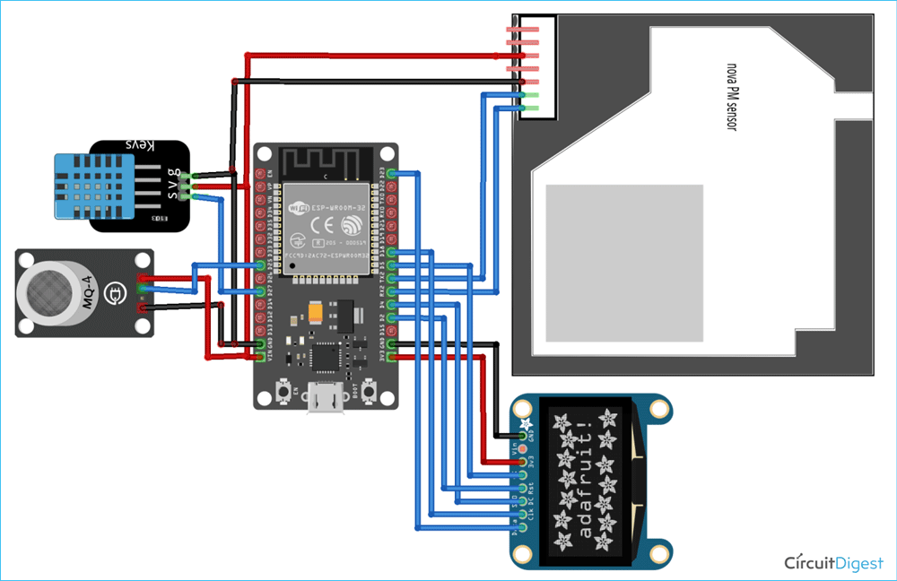

Slide 9
Program for circuit:
import RPi.GPIO as GPIO
import time
import requests
CO_SENSOR_PIN = 17
ALERT_API_URL = "https://your-alert-api-endpoint.com"
def read_CO_sensor():
GPIO.setup(CO_SENSOR_PIN, GPIO.IN)
try:

Slide 10
while True:
CO_value = GPIO.input(CO_SENSOR_PIN)
if CO_value == 0:
send_alert()
else:
Pass
display_CO_status(CO_value)
time.sleep(5)
except KeyboardInterrupt:
GPIO.cleanup()

Slide 11
def send_alert():
alert_data = {
"message": "Carbon Monoxide detected in the air!",
"location": "YourLocation"
}
response = requests.post(ALERT_API_URL, json=alert_data)
if response.status_code == 200:
print("Alert sent to authorities successfully.")
else:
print("Failed to send alert to authorities.")
def display_CO_status(co_value):
if co_value == 0:

Slide 12
print("CO Detected: Danger!")​
else:​
print("CO Not Detected")​
​
​
if _name_ == "_main_":​
try:​
read_CO_sensor()​
except Exception as e:​
print(f"An error occurred: {str(e)}")​
GPIO.cleanup()​
​
​
​
​

